Slide 1

BNY
Corporate Actions – Data Extraction
Week 4
Corporate Action Intelligence Team
Aesha Gandhi, Pranshul Bhatnagar, Alex Li, Kedar Vaidya, Aaron Jiang

Slide 2

Objectives for the Week
STEP 01
Finalize Filing Types
Mapped and finalized specific SEC filing types and supporting forms across all corporate action categories.
STEP 02
Load Action Data
Ingested, structured, and loaded underlying dataset files for every target corporate action type.
STEP 03
Explore Extraction Methods
Researched, prototyped, and coded field extraction pipelines tailored to specific assigned action types.

Slide 3
Data Extraction & Processing Files
Mapping Corporate Action Types to SEC Filings and Corpus Extraction Rules
Action Type
Status
Primary SEC Forms
Supporting SEC Forms
TENDER OFFER
COLLECTED
SC TO-T, SC TO-T/A, SC TO-I, SC TO-I/A
SC 14D9, SC 14D9/A
EXCHANGE
COLLECTED
SC TO-T, SC TO-T/A, SC TO-I, SC TO-I/A, S-4, S-4/A, F-4, F-4/A, 424B3
SC 14D9, SC 14D9/A, SC TO-C, 425, 8-K, 6-K
(Conditional - SC 13E3, SC 13E3/A)
RIGHTS ISSUE
COLLECTED
424B2, 424B3, 424B5, S-3, S-3ASR
8-K, 424B4
MERGER
COLLECTED
DEFM14A, PREM14A, S-4, S-4/A, SC 13E3, SC 13E3/A
8-K, 425
CONVERSION
COLLECTED
8-K, 424B2, 424B3, S-3, S-3ASR
10-K, 10-Q

Slide 4

Tender Offer: Document Package Architecture
Multi-document SEC filing relationships, document roles, and event-level processing hierarchy
Third-Party Tender
Bidder: SC TO-T (Schedule TO cover) → attaches Offer to Purchase (OTP) (Exhibit (a)(1)(A))
Target: SC 14D-9 (Subject company response)
Lifecycle Deltas: SC TO-T/A & SC 14D-9/A (Amendments for extensions, price changes, exhibits)
Issuer Self-Tender Branch
Issuer: SC TO-I + Offer to Purchase (OTP)
Target Response: SC 14D-9 usually absent (consolidated disclosures inside SC TO-I)
DOCUMENT ROLE PRIMARY EXTRACTION SCOPE PROFILE & STRUCTURE EXTRACTION ORDER
STEP 1
Anchor
Schedule TO Cover
Strong Item structure
Scope: Parties, CUSIP, form identity, exhibit pointers
~1.8k–2k words
STEP 2
Mechanics
Offer to Purchase (OTP)
TOC & narrative section-driven
Offer mechanics: Price, expiration, tender procedures, withdrawal rights, closing conditions
~16k words
STEP 3
Stance
SC 14D-9
Item structure (Item 4 focus)
Target response: Board recommendation, fairness opinion, background
~35k words
STEP 4
Reconcile
Amendments (/A)
Changed Items / diffs
Delta updates: Updates prior terms rather than restating the offer
~1k words
Notes:
Here, the main idea is that we should not treat each SEC filing as an independent document. For a tender offer, the actual unit of analysis is the overall event, which is made up of several related filings.
For a third-party tender, an outside buyer is acquiring the target company’s shares. The bidder typically files a Schedule TO-T, which acts as the cover filing, and that filing includes or points to the Offer to Purchase, or OTP.
The OTP is the main source for the actual offer mechanics, such as the price, expiration date, tender procedures, withdrawal rights, and closing conditions.
Separately, the target company files the 14D-9, which contains the target board’s response to the offer, including its recommendation, fairness discussion, and background.
As the deal changes over time, either side can file amendments. These are usually short delta filings that update specific terms, such as extending the deadline or changing the offer price, rather than restating the entire offer.
For a self-tender, the company is buying back its own shares, so the issuer files a Schedule TO-I plus the OTP, and a separate 14D-9 is usually not needed.
The lower section shows the extraction order we use. We start with the Schedule TO cover for metadata like the parties, CUSIP, and exhibit pointers. CUSIP here is just the identifier for the specific security being tendered. Then we move to the OTP for the core offer terms, the 14D-9 for the target’s stance, and finally the amendments to reconcile any changes.
So the key point is: we process the tender as one linked document package, not as isolated filings.

Slide 5
Structure-First Extraction Pipeline
Deterministic section routing and targeted local extraction using GLiNER and Regex
STEP 1
CLASSIFY
1. Document Role
Tag file as cover, otp, sc_14d9, or amendment.
Classification Targets: Schedule TO Cover, Offer to Purchase (OTP), SC 14D-9, Amendments (/A)
Establishes baseline document hierarchy and expected section maps before running downstream extractors.
STEP 2
ROUTE
2. Structure Routing
Deterministically find candidate sections instead of full-doc search
Schedule TO: Item headings (Item 1–Item 12) | OTP: TOC & narrative section titles
14D-9: Formal Item structure, isolating Item 4 (Solicitation/Recommendation)
Amendments: Changed Item markers or text diffs against prior filings
STEP 3
BOUND
3. Local Window
Isolate bounding spans around identified target headings
Context Bounding: Bounding spans of ~500–2,000 tokens focused strictly around located section anchors
Eliminates noise from long disclosures and reduces context window overhead for extraction models.
STEP 4
EXTRACT
4. GLiNER / Regex Extraction
Targeted entity extraction on bounded spans
Regex Rules: CUSIP, cash price, expiration date/time & time zone
GLiNER Model: Offeror/target entity roles, security classes, recommendation language
STEP 5
RECONCILE
5. Source-Aware Reconciliation
Resolve field conflicts across the package
Price & Expiration: Prefer OTP over cover page | CUSIP: Prefer Schedule TO cover
Board Stance: Prefer 14D-9 Item 4 | Temporal Deltas: Later amendment values supersede earlier values
“Structure finds where to look. GLiNER finds the value.”
Notes:
Once we know which documents belong to the tender, the next question is how we actually extract information from them.
The key idea is to use a structure-first pipeline instead of running an extraction model over the entire document.
First, we classify the document role: is this a cover, an OTP, a 14D-9, or an amendment? That immediately tells us what kind of information we should expect.
Then, we use the document’s native structure to route to the right section. For example, Schedule TO filings have predictable Item headings, 14D-9 has a strong Item structure with Item 4 being particularly important, while OTPs are better navigated using their table of contents and narrative section headings.
After that, once we find the relevant section, we isolate a relatively small local context window around it. This reduces noise from documents that can be tens of thousands of words long.
Only then do we run GLiNER or regex-based extraction. Regex works well for strongly patterned values like CUSIPs, prices, or dates. GLiNER is more useful for variable semantic entities such as the offeror, target, security names, or recommendation language.
Finally, we reconcile conflicts using the source context. So if multiple documents mention the price, we prefer the OTP. For CUSIP, we prefer the Schedule TO cover. For board stance, we prefer 14D-9 Item 4. And if an amendment changes a value, the later amendment supersedes the earlier one.
So the architecture is really summarized by the line at the bottom: structure finds where to look, and GLiNER finds the value

Slide 6
Exchange Offers: Preliminary Field Extraction Approach
FIELDS
PROPOSED EXTRACTION TECHNIQUE
EXPECTED DIFFICULTY / KEY CHALLENGE
Issuer, offeror and security names
Labeled sections + entity recognition (e.g., GLiNER)
Low–Medium: identify names, then distinguish company roles and old/new securities
CUSIP, ISIN and ticker
Label matching + table parsing + format checks
Low when present: associate each identifier with the correct security
Commencement and expiration dates
Heading/keyword matching + date patterns (regex)
Low–Medium: retain time zones and recognize amended deadlines
Exchange ratio and cash consideration
Section-based numeric patterns + contextual checks
Medium: distinguish final ratios from caps and separate consideration options
Election options and default choice
Election-section rules + semantic/NLP verification
Medium–High: interpret conditional choices and consequences of no election
Withdrawal and settlement timing
Date patterns + interpretation of timing clauses
Medium–High: information may be relative or conditional rather than a fixed date
Minimum thresholds, proration and other conditions
Clause/table extraction + NLP/LLM-assisted review
High: preserve exceptions, allocation rules and waiver provisions
Event status and revised terms
Compare announcements and amendments over time
Medium–High: reconcile changes across multiple filings
Approach: Locate relevant sections → extract candidate values → verify ambiguous terms → retain source evidence
Notes:
identifiers, dates, and basic consideration terms more structured – keyword matching, regex, and entity extraction
more conditional—like election options, proration, or amended terms— need more contextual NLP or LLM-based verification

Slide 7
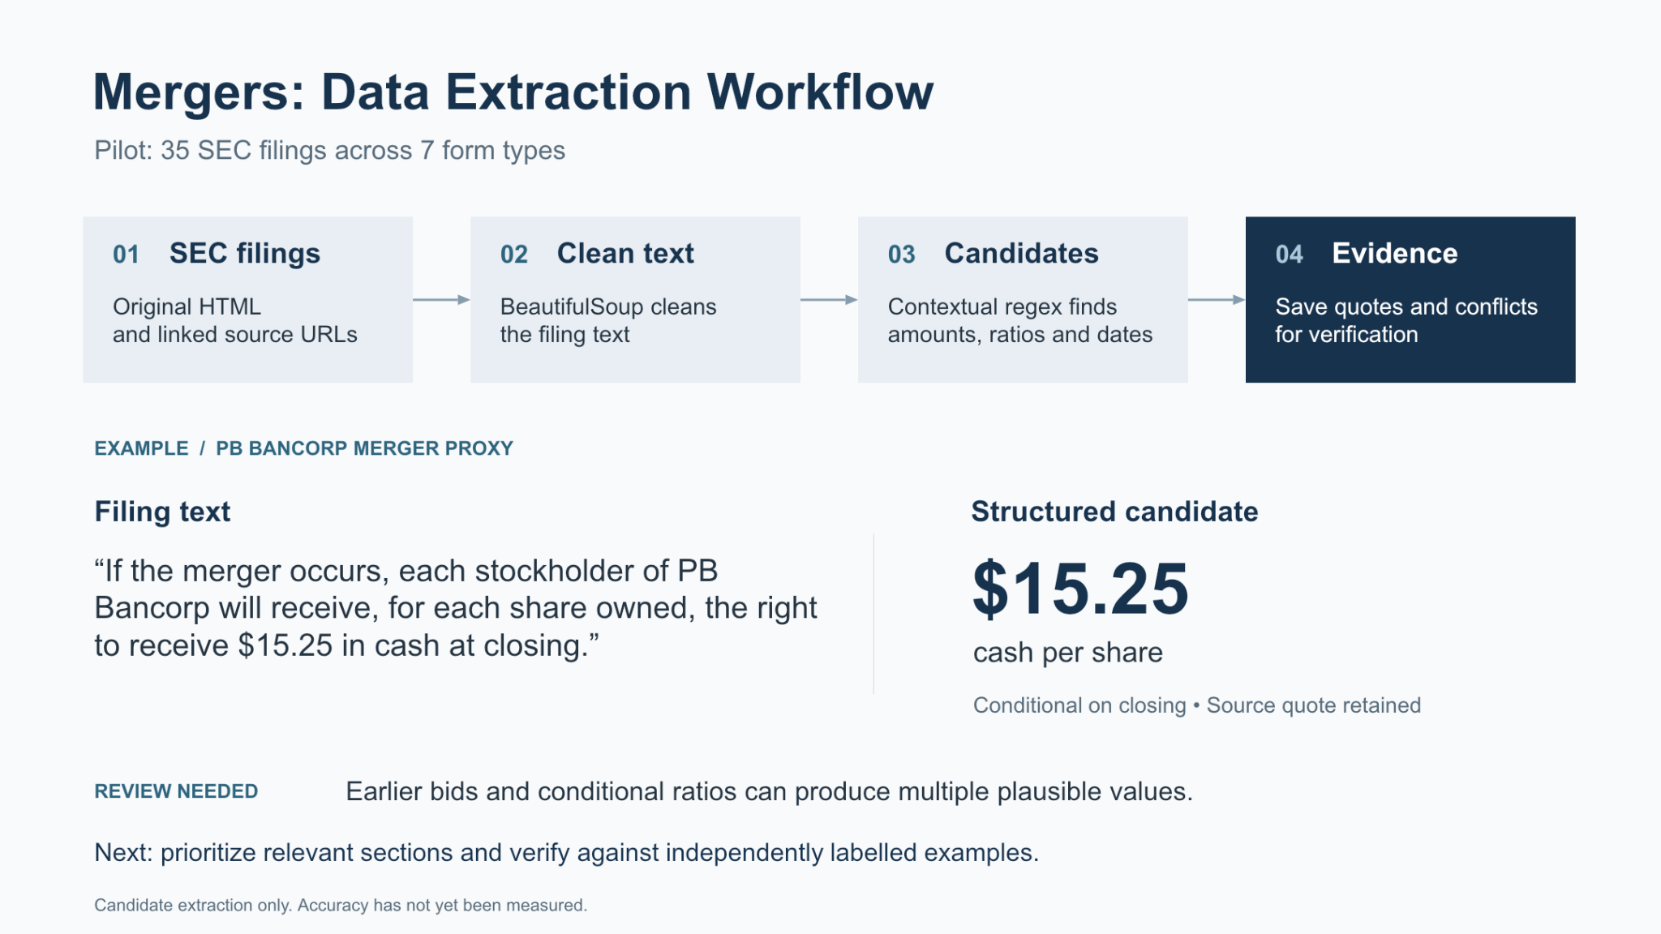

Slide 8
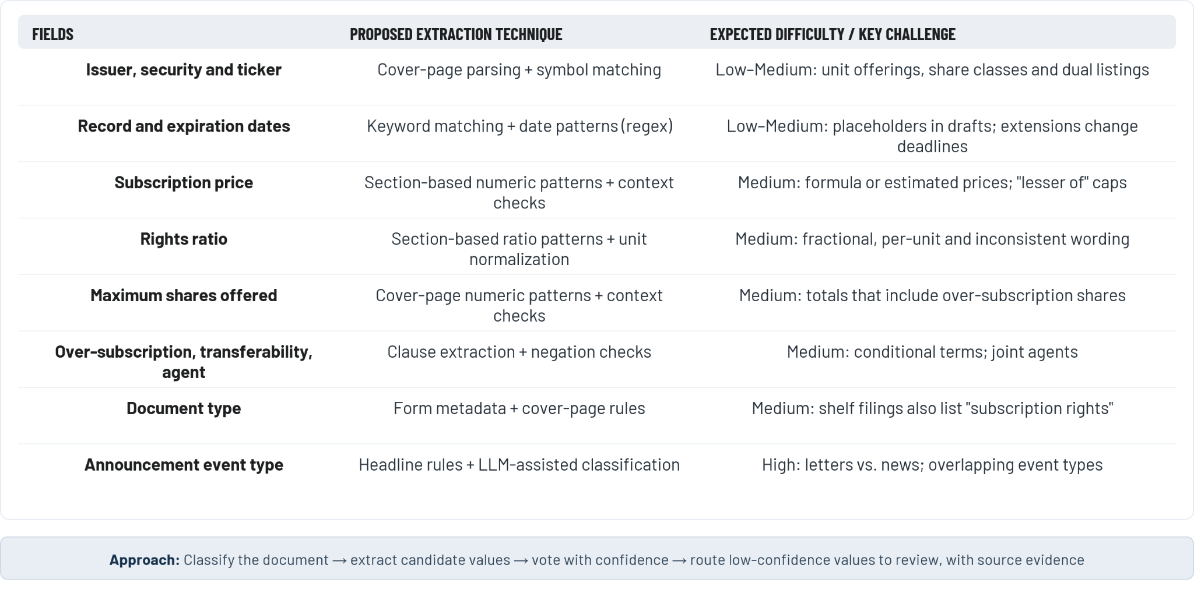
Rights Issues: Field Extraction Approach
Mapping Corporate Action Types to SEC Filings and Corpus Extraction Rules

Slide 9
END-TO-END OPERATIONAL PLAN
SEC Filing Conversion & Transaction Extraction Pipeline
Automated workflow for parsing EDGAR disclosures into verified structured terms.
01
Ingest & Group
02
Fetch Exhibits
03
Classify Event
Link filings by company CIK.
Download detailed deal agreements.
Distinguish standalone security conversions.
Group multi-party transaction filings.
Retrieve indentures and S-4 exhibits.
Isolate complex merger consideration.
04
Extract Terms
05
Attach Lineage
06
Version & Audit
Locate conversion rates and formulas.
Store citation per value.
Track term revisions across filings.
Save exhibit section and excerpt.
Route complex cases for review.
Preserve verbatim contingent conditions.

Slide 10
EXTRACTION FIELD SPECIFICATIONS
Conversions: Field Extraction & Complexity Analysis
Targeted extraction techniques and technical challenges for key conversion terms.
Fields | Proposed Extraction Technique | Expected Difficulty / Key Challenge
Issuer, offeror and security names | Identify labeled sections and defined terms; use entity recognition to link each security to its issuer | Low–Medium: distinguish issuer, holder, old security, and security received
Conversion type and direction | Match terms such as convertible, conversion, automatic conversion, and optional conversion in relevant sections | Medium: distinguish a stand-alone security conversion from shares converting in a merger
Conversion ratio or rate | Extract numeric terms near conversion rate, conversion ratio, or formula language; normalize units | Medium–High: ratios may be formulas, adjustable, or expressed as shares per dollar/value
Conversion price | Extract price and currency near conversion price; capture floor, cap, and adjustment rules separately | Medium: price may reset over time or change for anti-dilution events
Conversion date, deadline, or effective time | Match date headings and timing clauses; distinguish holder election deadlines from automatic effective dates | Medium–High: may depend on notice, approval, closing, or another future event
Conversion conditions and eligibility | Extract clauses on approvals, triggering events, minimum holdings, and eligibility; use LLM-assisted review | High: multiple conditions, exceptions, and cross-references may apply
Treatment of accrued interest, dividends, or fractional shares | Search adjacent "treatment" and "settlement" clauses; extract each component separately | High: cash, securities, accrued amounts, and rounding rules can vary

Slide 11
Thank You!
Questions & Discussion

